Slide 1
3d mri brain tumor segmentation

Slide 2
Objective To segment brain tumors from 3D MRI scans using image processing techniques in OpenCV and visualize the result.

Slide 3
1. Medical Diagnosis Assistance
Helps radiologists detect and localize brain tumors more easily by automatically segmenting tumor regions from MRI scans.
Saves time in manual analysis of large 3D MRI dataset
2. Treatment Planning
Provides accurate tumor volume and location for planning surgeries, radiotherapy, or chemotherapy.
Helps in tracking tumor growth or shrinkage over time.
3. Monitoring Tumor Progression
Allows comparison of segmented tumors over time to evaluate treatment effectiveness.
Helps doctors observe changes in tumor size and shape during follow-up.
3. Monitoring Tumor Progression
Allows comparison of segmented tumors over time to evaluate treatment effectiveness.
Helps doctors observe changes in tumor size and shape during follow-up.

Slide 4
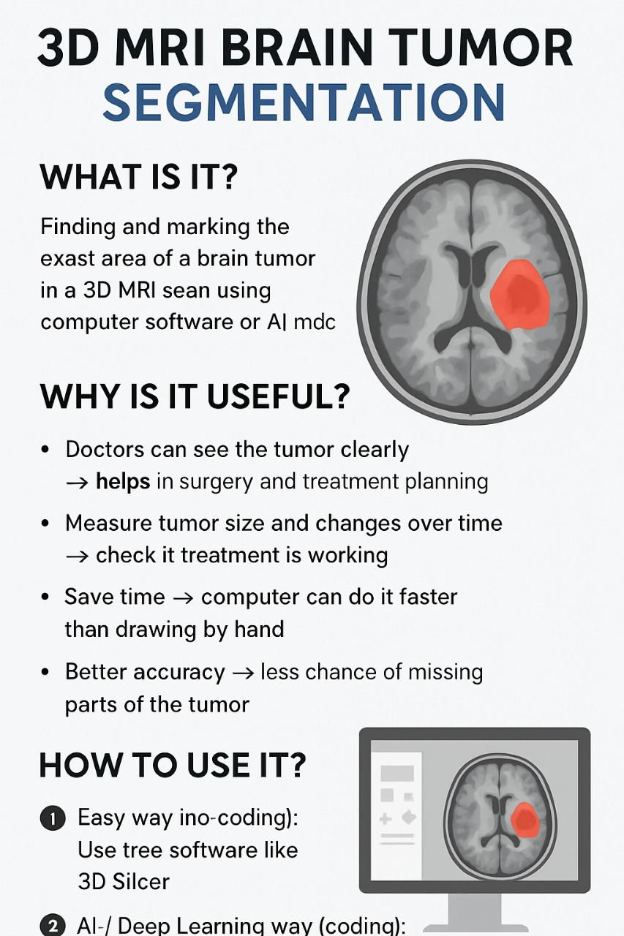

Slide 5
Summary of Uses: 1. Assist diagnosis 2. Aid treatment planning 3. Monitor tumor progression 4. Academic research 5. Education & learning 6. Dataset annotation 7. Cost-effective medical solution

Slide 6
THANK YOU

